Slide 1
EMS Interoperability Task Force January 11, 2024
Patient Identification and Record Matching
Notes:
This meeting is being recorded and will be posted. If you need anything removed from the recording, let us know.
Note change to moderated format, use hand raise feature to be acknowledged to speak.
Any new participants?

Slide 2
Task Force Overview
Monthly, 2nd Thursday, 11a–12:30p MT
Jan 11, Feb 8, Mar 14, Apr 11, May 9, Jun 13
Topics:
2/23: Identifying data exchange partners and establishing relationships
3/23: Governmental, regulatory, and contractual environment
4/23: Regulatory environment and national networks recap
5/23: Sequence/workflow: SAFR design
6/23: Sequence/workflow
7/23: Standards and profiles overview
Specific standards and profiles to use in workflow:
8/23: EMS to Hospital
9/23: Hospital Outcomes to EMS
10/23: Patient History to EMS
11/23, 1/24: Patient identification and record matching
APIs
Data elements to be shared and parsed
Notes:
Reminder of task force purpose: to help EMS software vendors develop interoperability solutions for their customers
We’ve scheduled 2024 meetings through June, will use as needed

Slide 3
EMS Data Summit
Recording:
https://youtu.be/vcO4Nylxdv4
Coming soon:
“What we Heard” overview
Meeting summary

Slide 4
Today’s Topic
Standards and profiles to use in the patient identification stage of the interoperability workflow

Slide 5
Today’s Questions
What standards and profiles are used for the Patient Discovery phase of the interoperability workflow?
What actor/role does EMS software play in those profiles?
What resources can help us improve patient matching?

Slide 6
Discussion
John Moehrke: IHE profiles for patient identification
Catherine Lusk: AHIMA patient naming policy

Slide 7
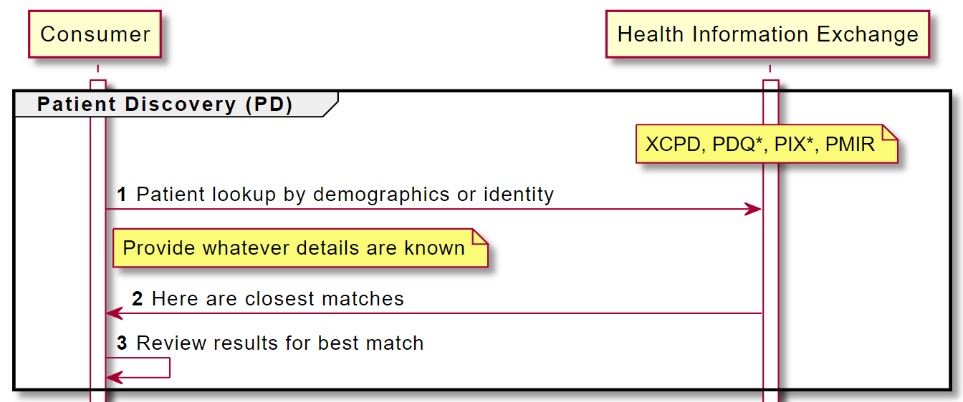

Slide 8

Did We Answer Today’s Question?
What standards and profiles are used for the Patient Discovery phase of the interoperability workflow?
What actor/role does EMS software play in those profiles?
What resources can help us improve patient matching?
Notes:
Give link to survey in chat:
https://forms.office.com/r/Z1ER9MqctE

Slide 9
Next Steps
Survey for today’s task force call
Task Force Email Group
groups.google.com/g/ems-task-force
Github Repository and Wiki (includes link to sequence diagram)
github.com/IHE/EMS
Next Task Force topics
Notes:
Thinking of covering APIs next (IHE XDS, MHD, XDR, XCDR, 360X).
After that, we need EMS and hospital provider perspectives to help us identify the information they need in the interoperability workflow.

